Slide 1
CURRICULUM FOR DANCE DANCE AS THERAPY
PROJECT “HIGH FIVE”
No: 2020-1-TR01-KA201-093256 C1 LTTA ROMÂNIA
CENTRUL SCOLAR PENTRU EDUCAȚIE INCLUZIVĂ TG-JIU

Slide 2
OUR PURPOSE
Creating a dance curriculum to be piloted for a period of one month, two hours a week

Slide 3
The curriculum structure includes:
- Introductory note
-Equipment and resources:
- Methodological suggestions
- Ways to evaluate the results
- General skills
- Specific skills and examples of learning activities
-Contents

Slide 4
Introductory note
The Dance curriculum aims to bring to the fore a teaching activity aimed at students with disabilities.
Music and dancing are effective in mentally and physically relaxing students with C.E.S., in addition they train the body, releasing negative energy. The non-verbal, creative, and affective nature of music facilitates self-knowledge, self-expression, communication, and personal development of students with C.E.S.
Through movements coordinated with a rhythm, the most varied feelings were expressed, from sadness to joy, from anger to love. Dance and movement therapy is a form of art therapy, which starts from the idea that movement can influence the mental state, being, in this context, a form of expression and communication meant to help the individual to develop, heal and gain a general state of well-being.
In students with special educational needs, dance therapy is a way of expressing, expressing feelings, it is a primary instinct that all students have and through this instinct you get body movement leading to increased muscle tone, coordination and balance and joint mobility.
Children will learn to diminish and control negative feelings and, why not, even eliminate them. From a physical point of view, dancing keeps them in shape, tones the muscles of the legs, develops mobility and is a pleasant way to burn calories. Dance sessions also benefit the respiratory and circulatory systems and help to improve balance.
Dance therapy can also be seen as a means of self-knowledge, reduces the difficulties of communication or expression, helps to express feelings. When done in a group, participants can and do interact easily. Dance and movement therapy helps to express yourself more easily, especially if you have difficulty speaking freely in front of a group.

Slide 5
Equipment and resources:
- computer, laptop, tablet, smartphone, video projector
- educationally useful sites - www.pinterest.com; , www.MontessoriFromtheHeart.com; https://www.youtube.com/;

Slide 6
Methodological suggestions:
Each child with SEN has individual features and relationships with the environment, traits
which requires a personalized assessment and approach. Lack of focus on children with special needs, lack of motivation for learning, short-term memory and other individual features, require as for obtaining the best possible results in dance therapy activities, the most frequent use of the didactic game in all its forms. In this sense, the teacher will insist on waking up the child's interest in dancing and the development of self-confidence. The didactic game will predominate, providing the context for active, individual and group participation that allows free expression of one's feelings. Emphasis will also be placed on spontaneity and the creativity of the child's manifestations.
The movement on music, in the case of students with special educational needs, means:
- clapping on the hands, knees, chest, etc .;
- equal steps, on the spot or on the move;
- simple dance steps;
- rhythmic lifting on peaks;
- movements of the arms, of the torso;
- movements suggested by the text of the song (actions, characters);
- handling musical toys;
- intuitively directed.

Slide 7
Ways to evaluate the results
Recommended with priority modern approach to assessment as a learning activity. In this context, methods are appropriate such as: systematic observation of students' behavior, following personal progress in natural contexts, adapted to age and disability. It is it is recommended that the assessment be made according to specific standards for students with SEN.
The assessment also guides the teacher in adjusting the teaching strategies according to the individual and age characteristics of the students.
The assessment process will focus on the recognition of learning experiences and skills acquired by children in non-formal contexts.
The child's evolution will be recorded, communicated and discussed with parents.
Throughout the learning and assessment activity will be monitored, encouraged and valued the progress of each child.

Slide 8
General competencies :
1.Influencing the healthy, correct and harmonious evolution of the body by respecting the rules of personal hygiene and the prevention of sports accidents;
2.Developing the ability to receive the rhythm of a song;
3.Formation and development of skills and abilities to interpret a choreographic text in the rhythm of music;
4.Stimulating the interest and motivation for dancing.

Slide 9
General competencies 1 | Influencing the healthy, correct and harmonious evolution of the body by respecting the rules of personal hygiene and the prevention of sports accidents
Learning outcomes (reference objectives) | Example activities:
1.1.to understand the role of dance in ensuring the health of the body | -discussions with students and parents accompanied by necessary arguments; -using demonstrative videos
1.2 to know and respect the hygiene rules; | -use of special equipment for rehearsals (training) and other special equipment for celebrations or competitions; -using strictly personal accessories;
1.3 to comply with the rules of hygiene and accident prevention | -rehearsal and training activities in an adequate space and with permanent supervision

Slide 10
General competencies 2 | Developing the ability to receive the rhythm of a song
Learning outcomes (reference objectives) | Example activities:
2.1 to listen to songs of different genres | -music auditions using different equipment (computer, video projector ...); -dividing the listened songs into categories (happy / sad, slow / fast ...)
2.2 to reproduce different combinations rhythmic (with low or medium degree of difficulty); | -exercitii ritmice folosind batai din palme, din picior, cu creionul în bancă; -utilizarea unor instrumente simple gen-tobe farfurii și linguri, bețe de lemn sau plastic pentru reproducerea unui ritm propus - -measuring the rhythm by counting and performing simple arm or leg exercises in 2 and 4 strokes;
2.3 to be aware of the connection between rhythm melody and construction of movement | - -rhythm correlation exercises with music in 4 and 8 times; - performing the movements in the given rhythm, modifying it (andante → allegro)

Slide 11
General competencies 3 | Formation and development of skills and abilities to interpret a choreographic text in the rhythm of music
Learning outcomes (reference objectives) | Example activities:
3.1 to repeat simple movements according to the model | -specific exercises for each body segment; -repeats of progressive exercises from easy to hard, from simple to complex, from slow rhythms to fast rhythms;
3.2 to perform combinations of exercises and steps dancing to the music | -executing the movements with counting or naming the hand and the foot that executes the movement (counts the proposer or all in the choir); - individual and group execution of movements with indications and help when necessary; -repeating the proposed dance on small fragments and then in its entirety; -particularization of movements depending on the dance; -binding the learned elements in melodic and rhythmic lines; - creating rhythmic combinations according to your favorite song; -music games, contests, videotape viewings, music auditions;

Slide 12
General competencies 4 | Stimulating the interest and motivation for dancing
Learning outcomes (reference objectives | Example activities:
4.1 to be aware of the importance of practicing this dance activities; | -explaining the benefits that dance brings in harmonious physical development; -exemplifying the benefits of dance with the help of photos, videos, ppt presentations;
4.2 to collaborate with other colleagues and to develop a competitive spirit | - practicing different forms of organization during a dance (in line, in columns, individually, in pairs, in groups of 3-4 participants ... -explaining and applying organizational rules; -participation in celebrations, contests.

Slide 13
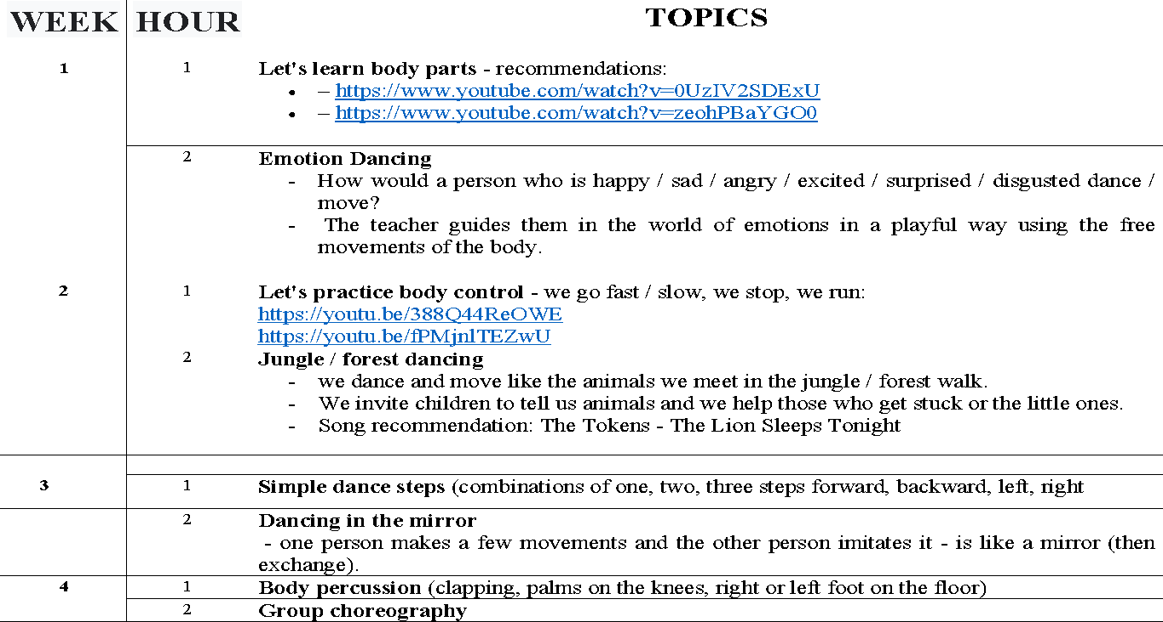
CONTENT PLANNING

Slide 14
“The European Commission support for the production of this publication does not constitute an endorsement of the contents which reflects the views only of the authors, and the National Agency and Commission cannot be held responsible for any use which may be made of the information contained therein”.

